Slide 1
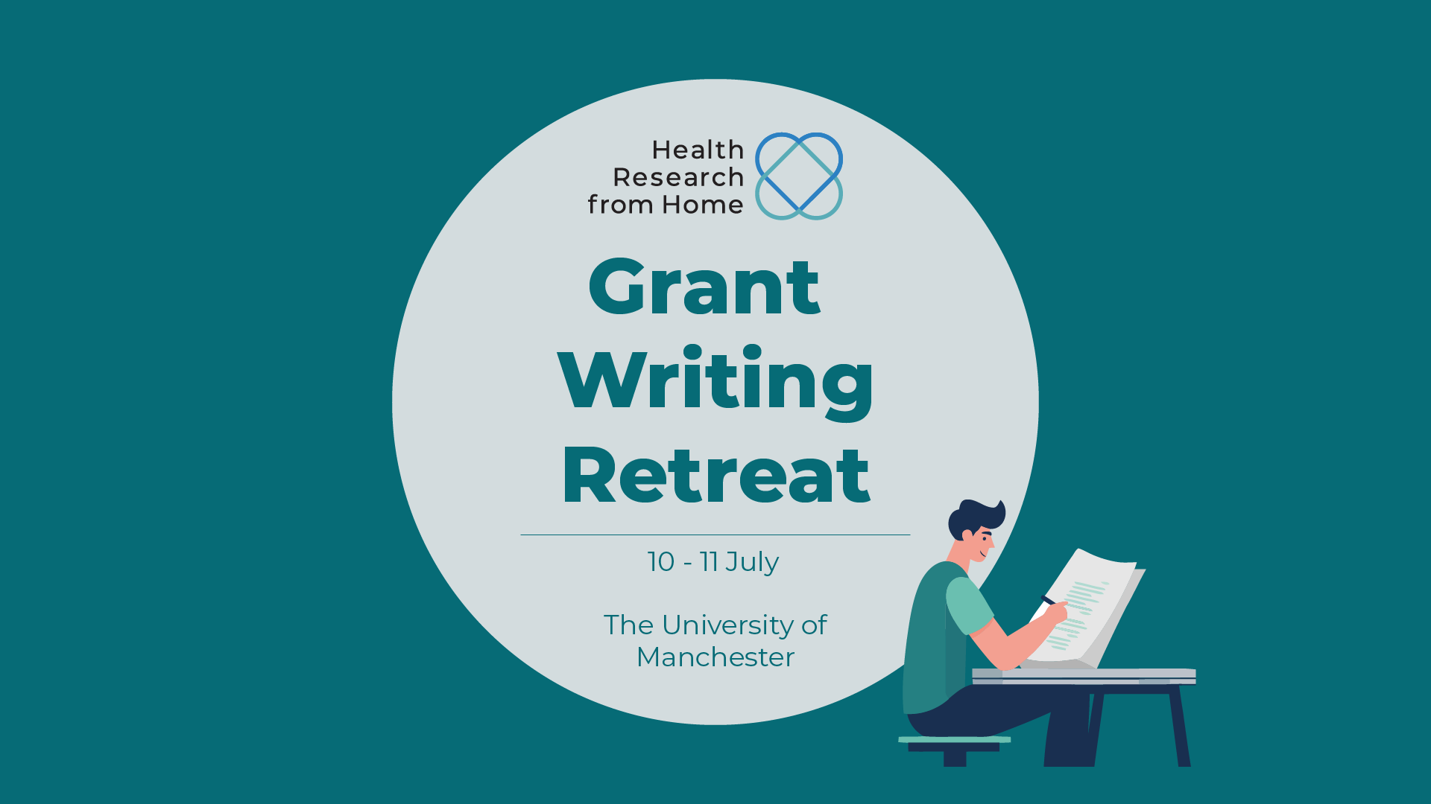

Slide 2

Opening session
Introduction to Health Research from Home
Purpose of the grant writing retreat
Agenda for the event
And introduction to the faculty
Getting to know you

Slide 3
Opening session
Introduction to Health Research from Home
Purpose of the grant writing retreat
Agenda for the event
And introduction to the faculty
Getting to know you

Slide 4
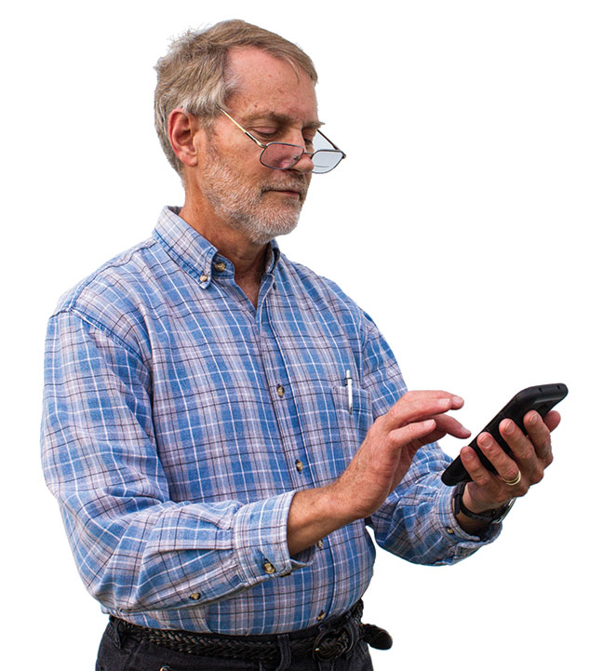
- Right care at the right time
for better and earlier treatment
- Clearer picture of disease
for better shared decision making
Patient-Generated
Health Data
Clinical care
- Improved understanding of disease,
including triggers
- Personalized coaching with
digital interventions
- Advancing understanding of:
--- Disease burden and progression
--- Causes and consequences of disease
- Enabling early detection and prediction
- Development & testing of digital interventions
Self-management
Population health
research

Slide 5
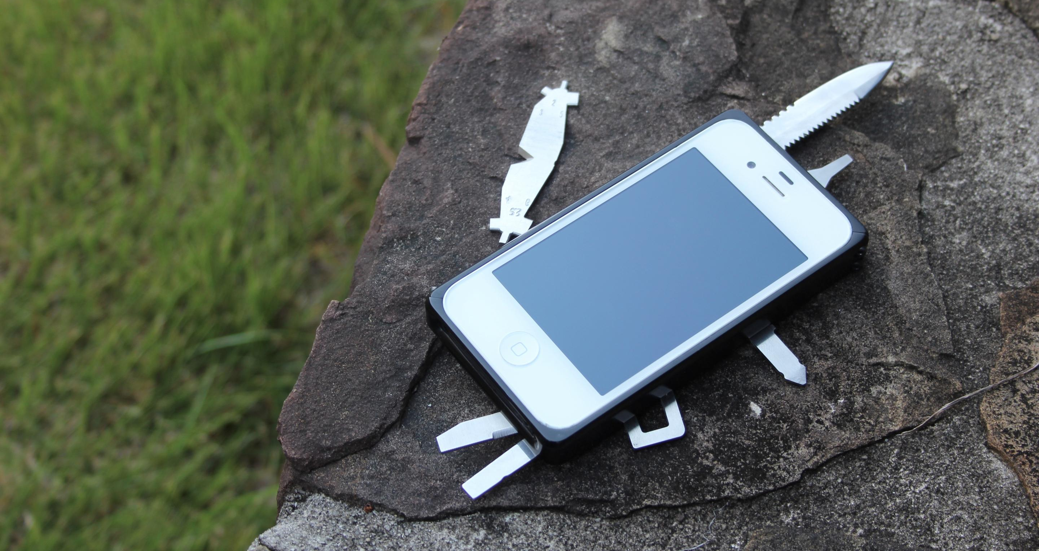
1. Novel data collection
Touch screen
Questionnaires
Smartphone interactions
Accelerometer + gyroscope
Physical activity
Camera
Heart rate, respiratory rate
Video selfies
Microphone
Voice commands
Cough, snore, tremor
GPS
Geolocation

Slide 6
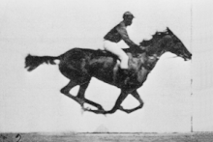
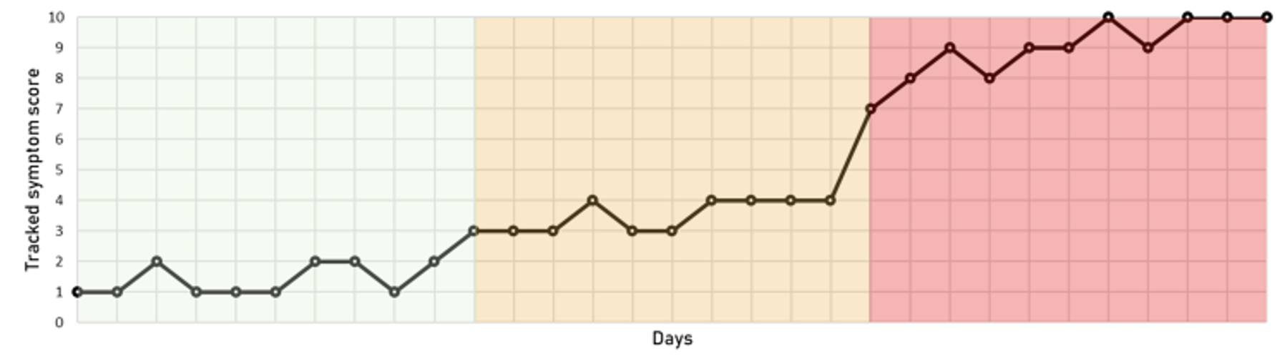
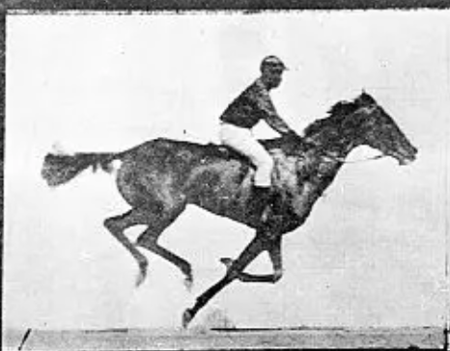
2. Tracking disease through time
?
Time

Slide 7
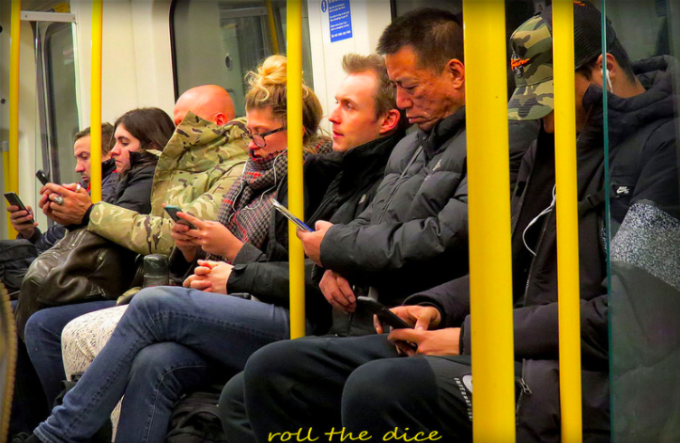
3. Widespread use
Image: Roll the Dice

Slide 8
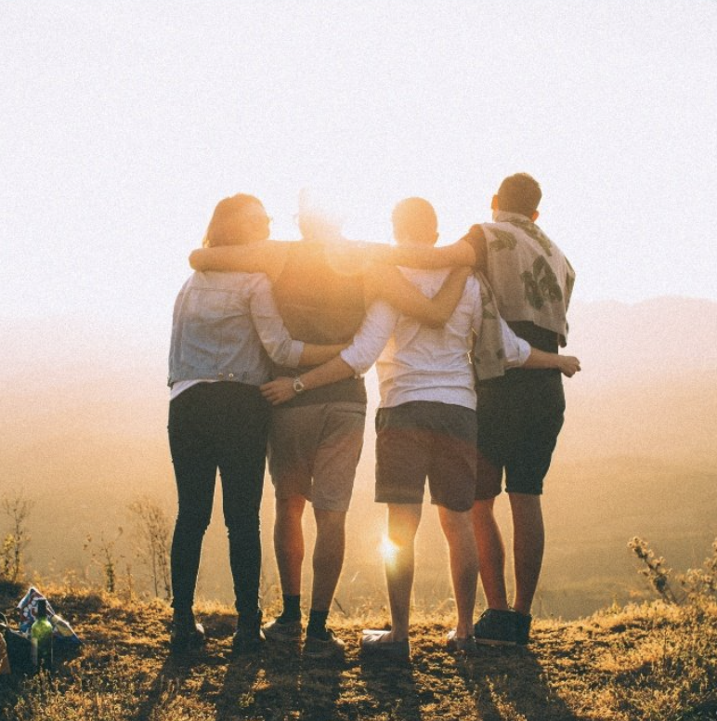
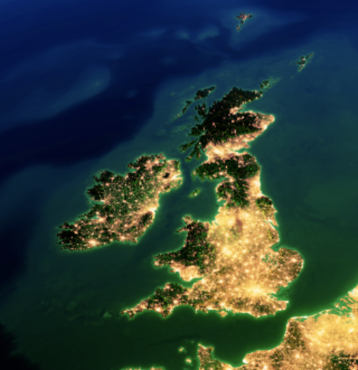

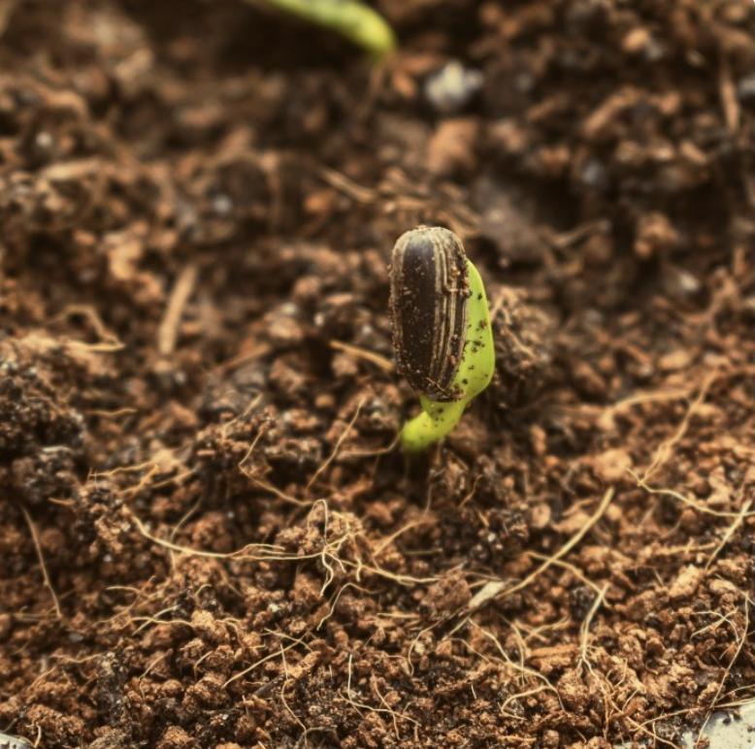
Purpose, vision, mission, values
Our purpose
To improve the lives of people living with long-term conditions
Our vision
To make the UK a world-leader in large-scale, high quality health research using smartphones and wearables, with linkage to national health data assets
Our mission
To build a collaborative community sharing know-how, skills and experience to catalyse and enable future ‘Health Research from Home’
Our values
Creating a cross-sector environment and public partnership where excellent ideas will thrive, inclusive of all perspectives and disciplines

Slide 9
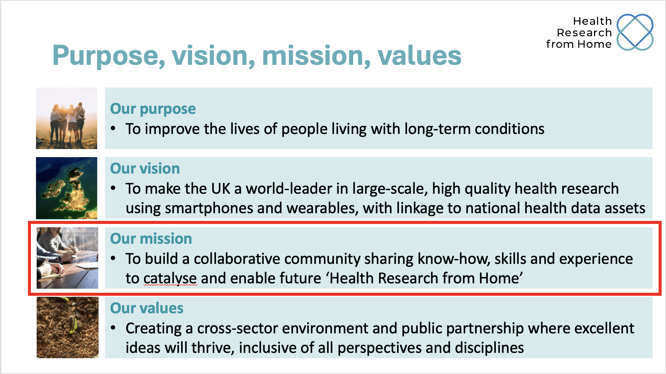
Opening session
Introduction to Health Research from Home
Purpose of the grant writing retreat
Agenda for the event
And introduction to the faculty
Getting to know you

Slide 10
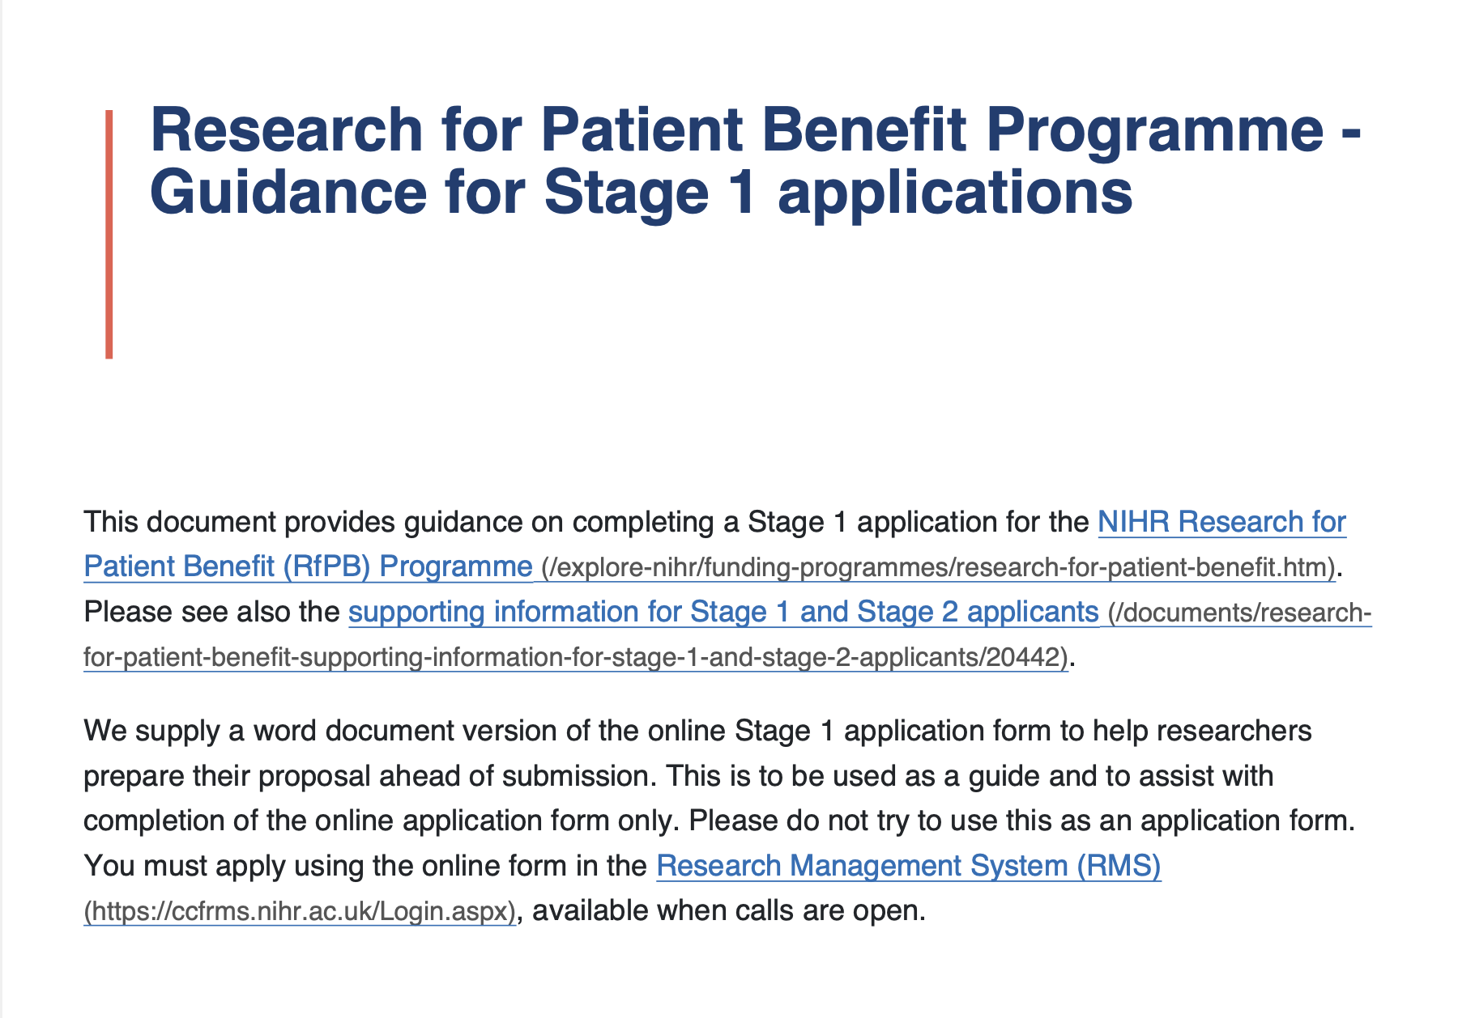
Purpose of the grant writing retreat
To help you present a better (and successful) grant application, with particular focus on grants specific to smartphones and wearables
Background
Aims and objectives
Methods
PPIE

Slide 11
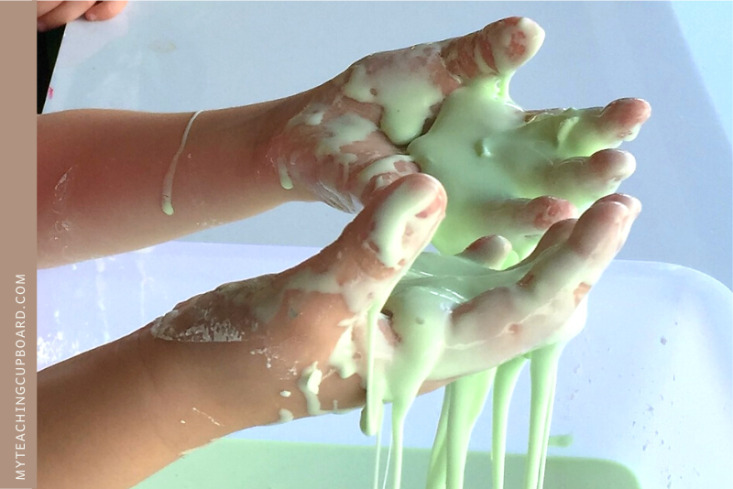
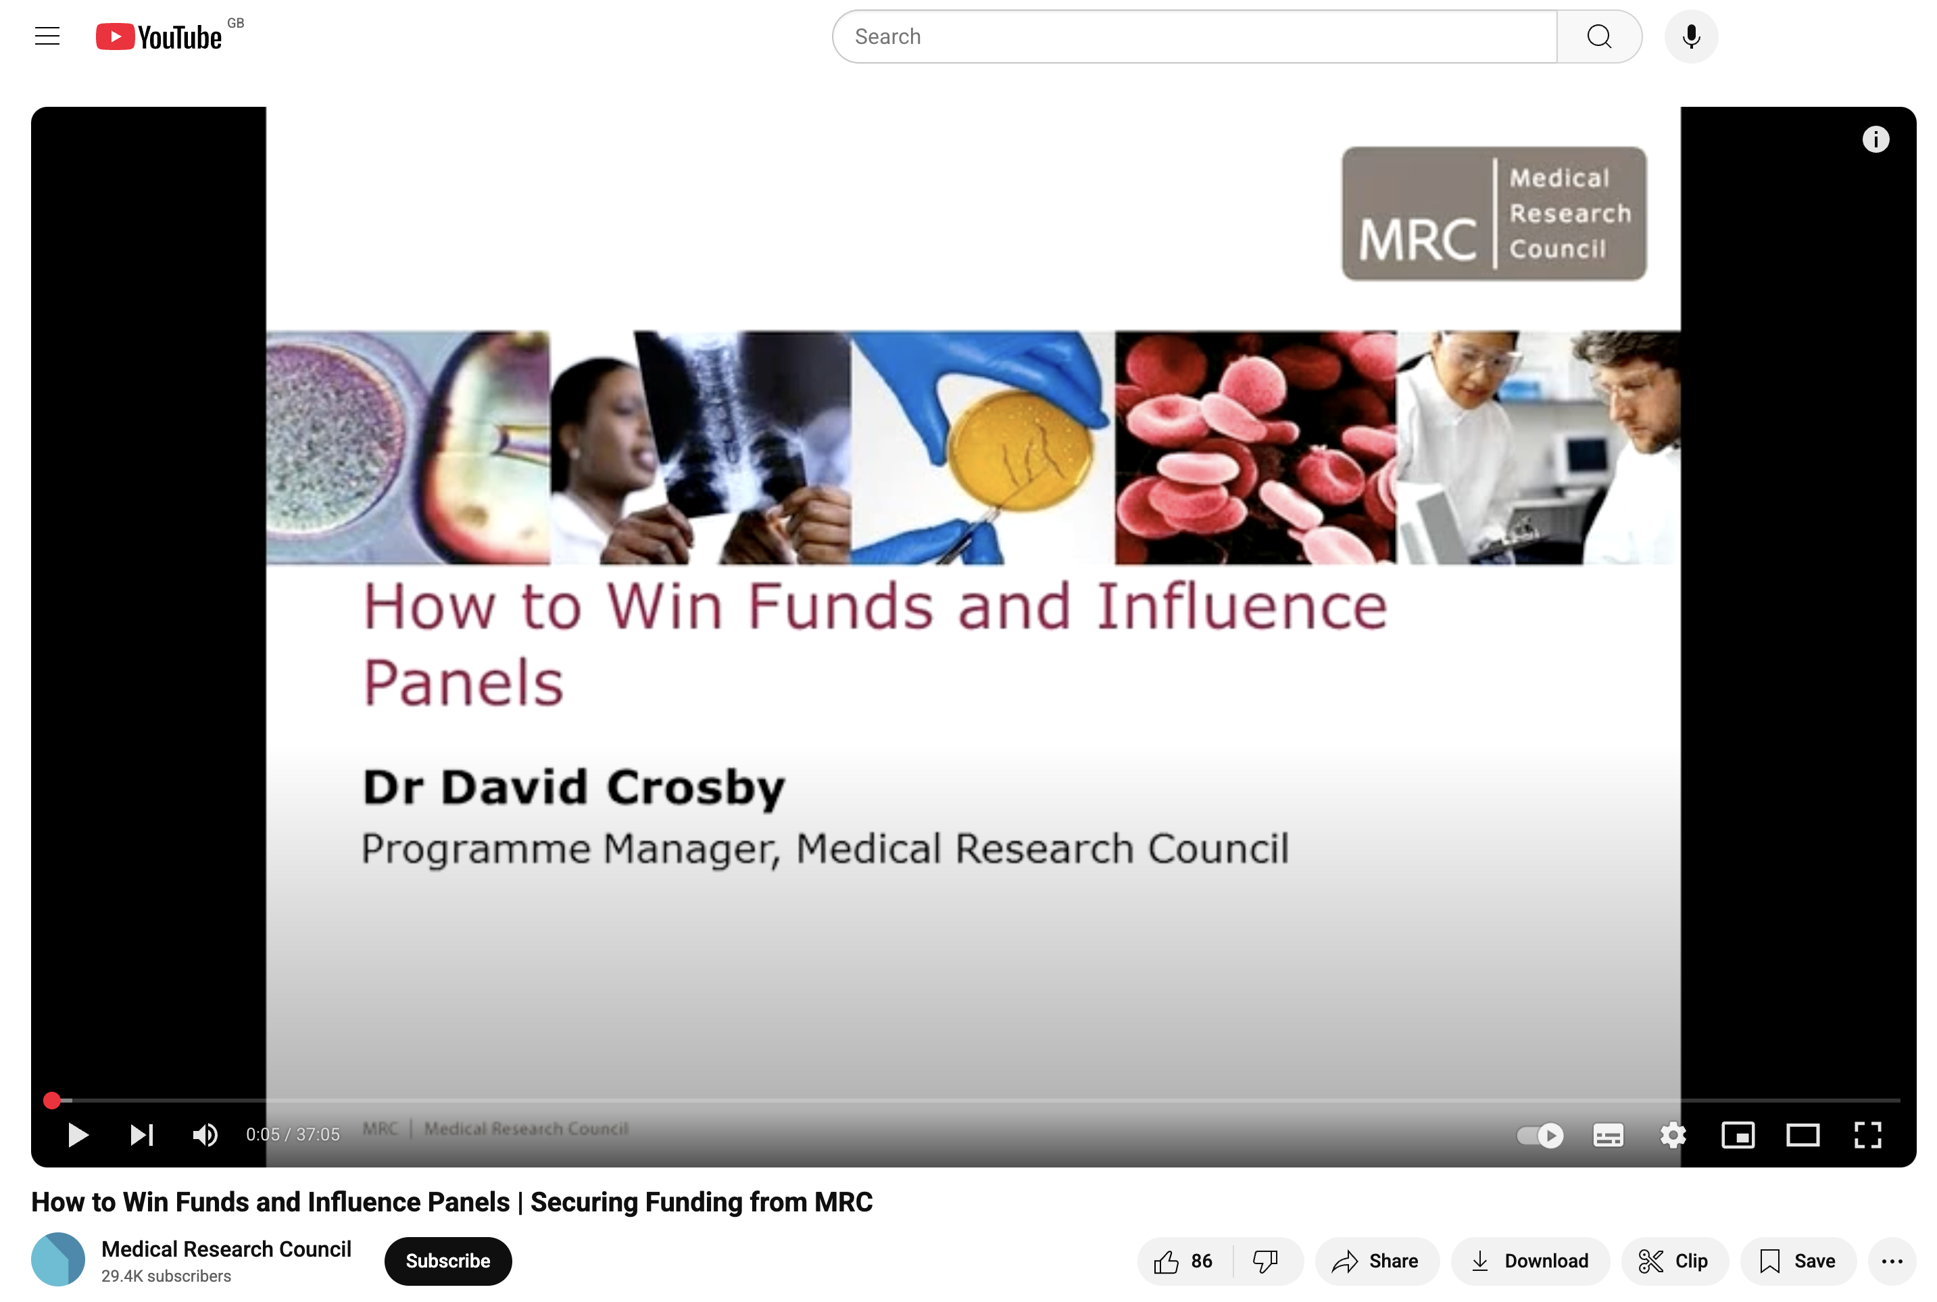

Slide 12
Opening session
Introduction to Health Research from Home
Purpose of the grant writing retreat
Agenda for the event
And introduction to the faculty
Getting to know you

Slide 13
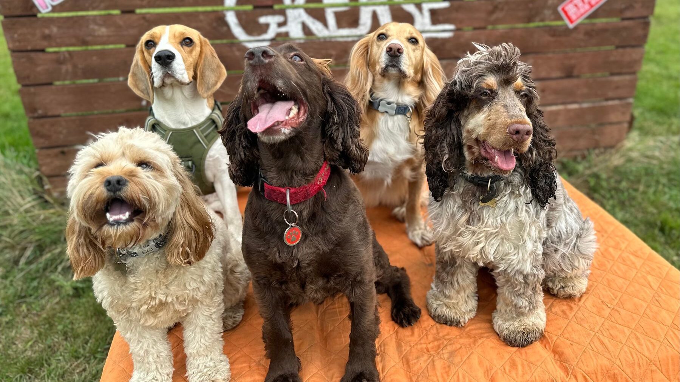
Introduction to the faculty

Slide 14
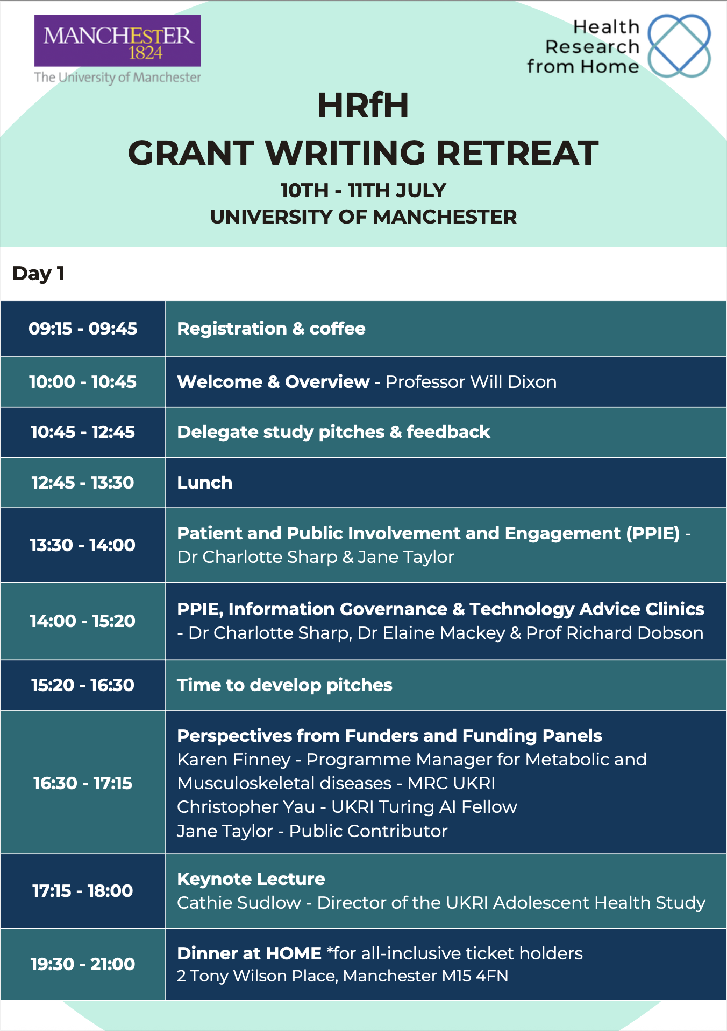

Slide 15
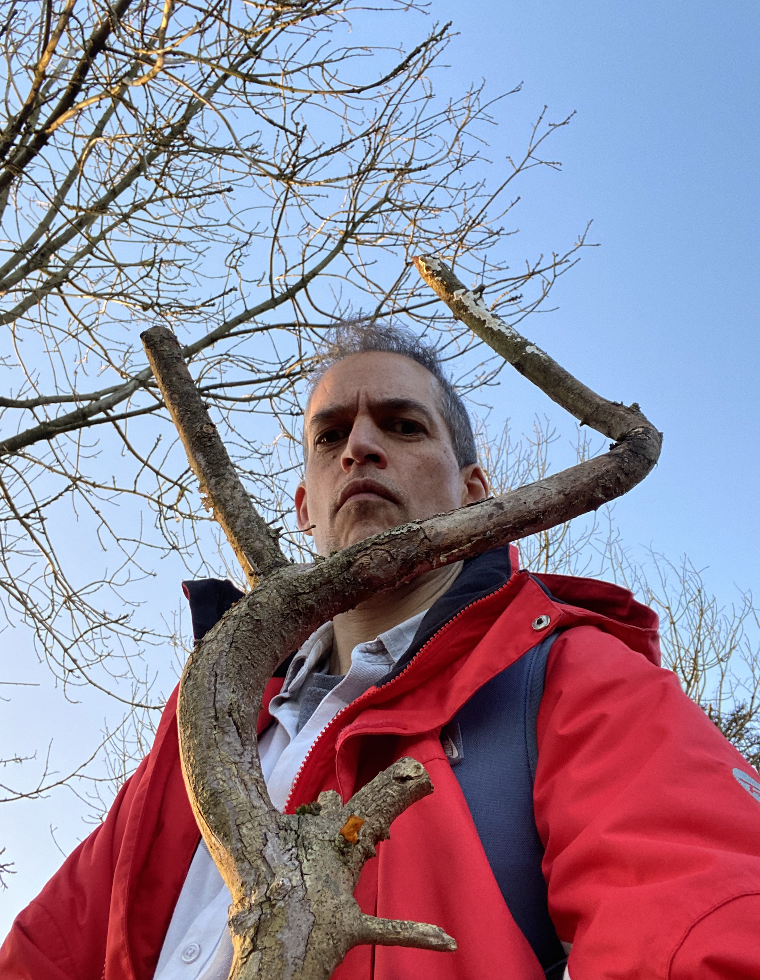
Will Dixon
Prof of Digital Epidemiology
Consultant Rheumatologist
Lead for Health Research from Home
Enjoys a good stick
Landlord of The Pike and Bittern

Slide 17
Pitches v1
Pre-event briefing
5min presentation of a study idea using smartphones +/or wearables
To include
Background/ motivation
Aims and objectives
Methods e.g.
Population, what data is collected and how, analysis plan
Divided into three groups
Each group of 6-7 to select two projects to take forwards (teams of 3-4)

Slide 19
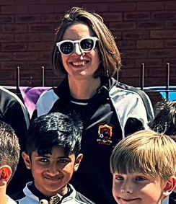
Charlotte Sharp
Honorary Senior Clinical Lecturer
Consultant Rheumatologist
Academic lead for patient and public involvement and engagement
My toughest role in life is coaching u9s football

Slide 20
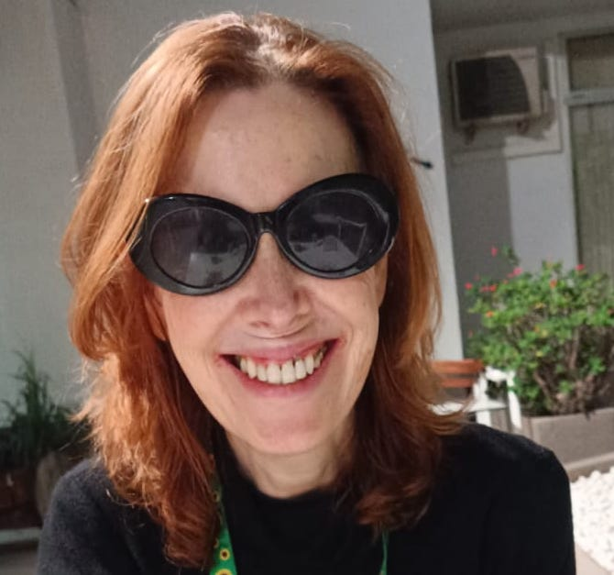
Jane Taylor
Public Contributor – co-produced research for over 20 years as both a patient and a carer.
Worked with national and international research organisations and funders to encourage the involvement of patients/carers in all aspects of the research process.
Also a carer and part time academic so any spare time is usually spent watching Netflix with a bottle of wine!

Slide 22
Advice clinics
PPIE
Charlotte, Leila, Jane and Hannah
Information Governance
Elaine, Rachel and Louise
Technology
Richard, Amos and Yatharth
Incorporate your learning into your Day 2 pitches

Slide 23
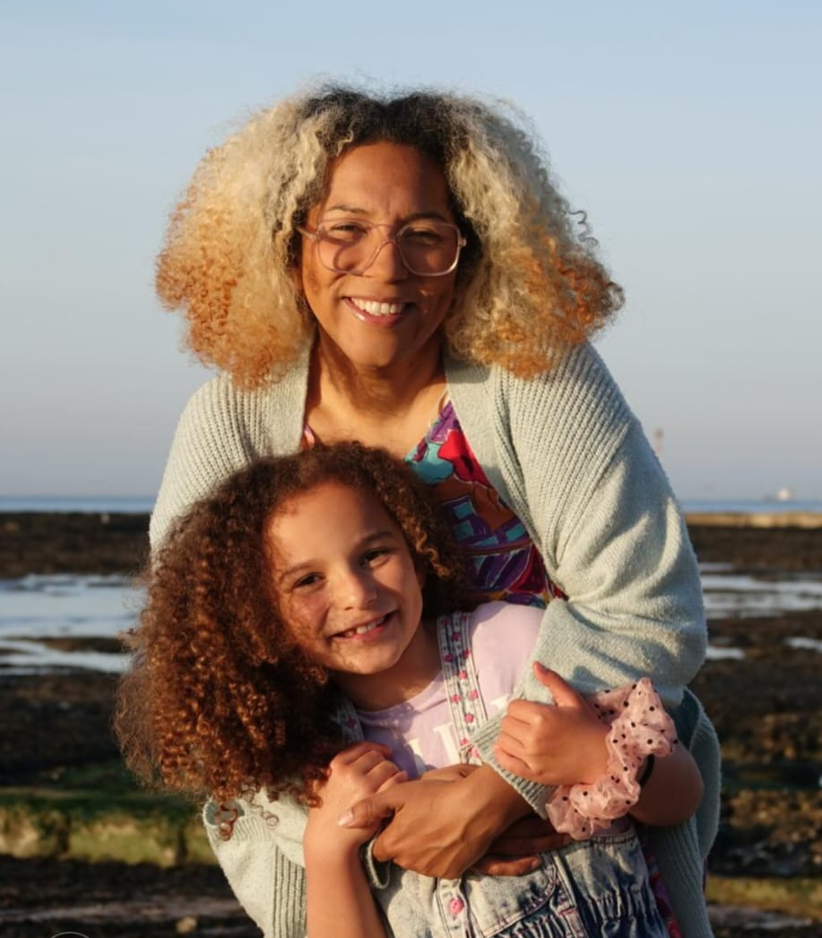

Hannah Turner-Uaandja
Public Involvement and Engagement Associate at Vocal
Co-Exec Director at We, the Catalyst
Love being in or near water
This summer you'll find me camping, fossicking and bbqing!

Slide 24
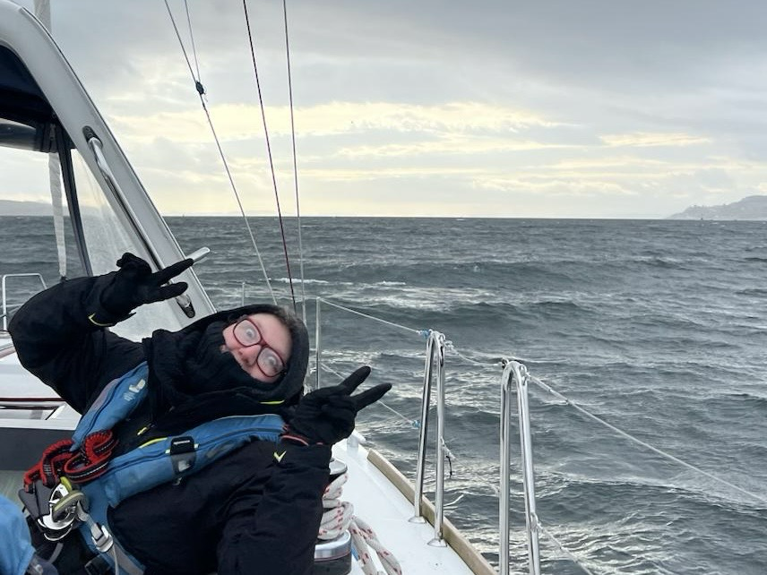
Leila Hamrang
Add picture outside of work
Public Contributor working with clinical researchers to improve public/patient engagement
Co-applicant
Enjoys playing wheelchair rugby and basketball, sailing and being creative!

Slide 25
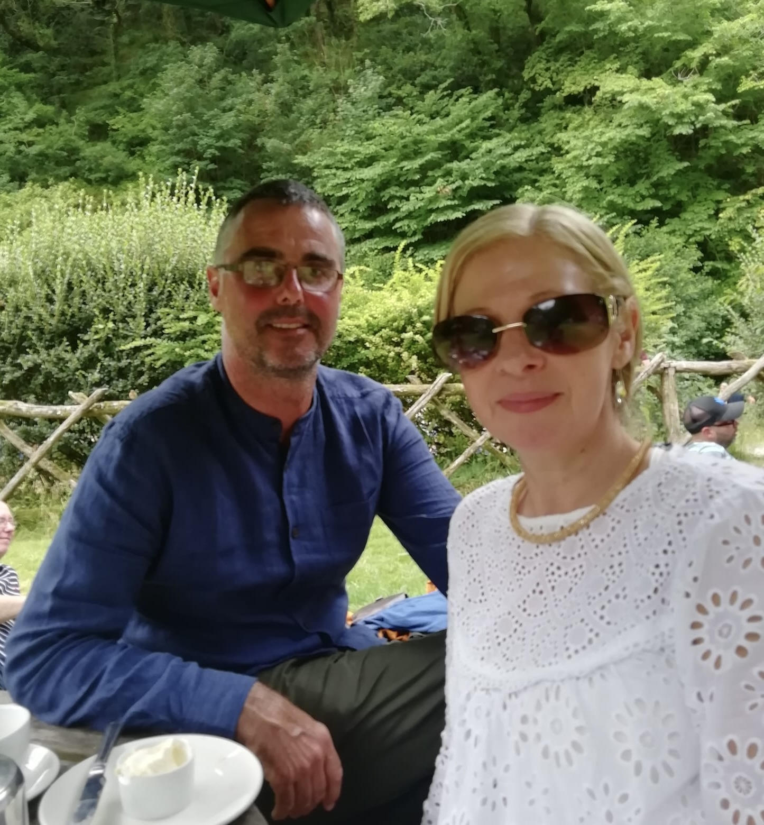
Elaine Mackey
Add picture outside of work
Research Information Governance Manager
Expertise in anonymization and data confidentiality
Enjoy walking, preferably when cake is involved

Slide 26
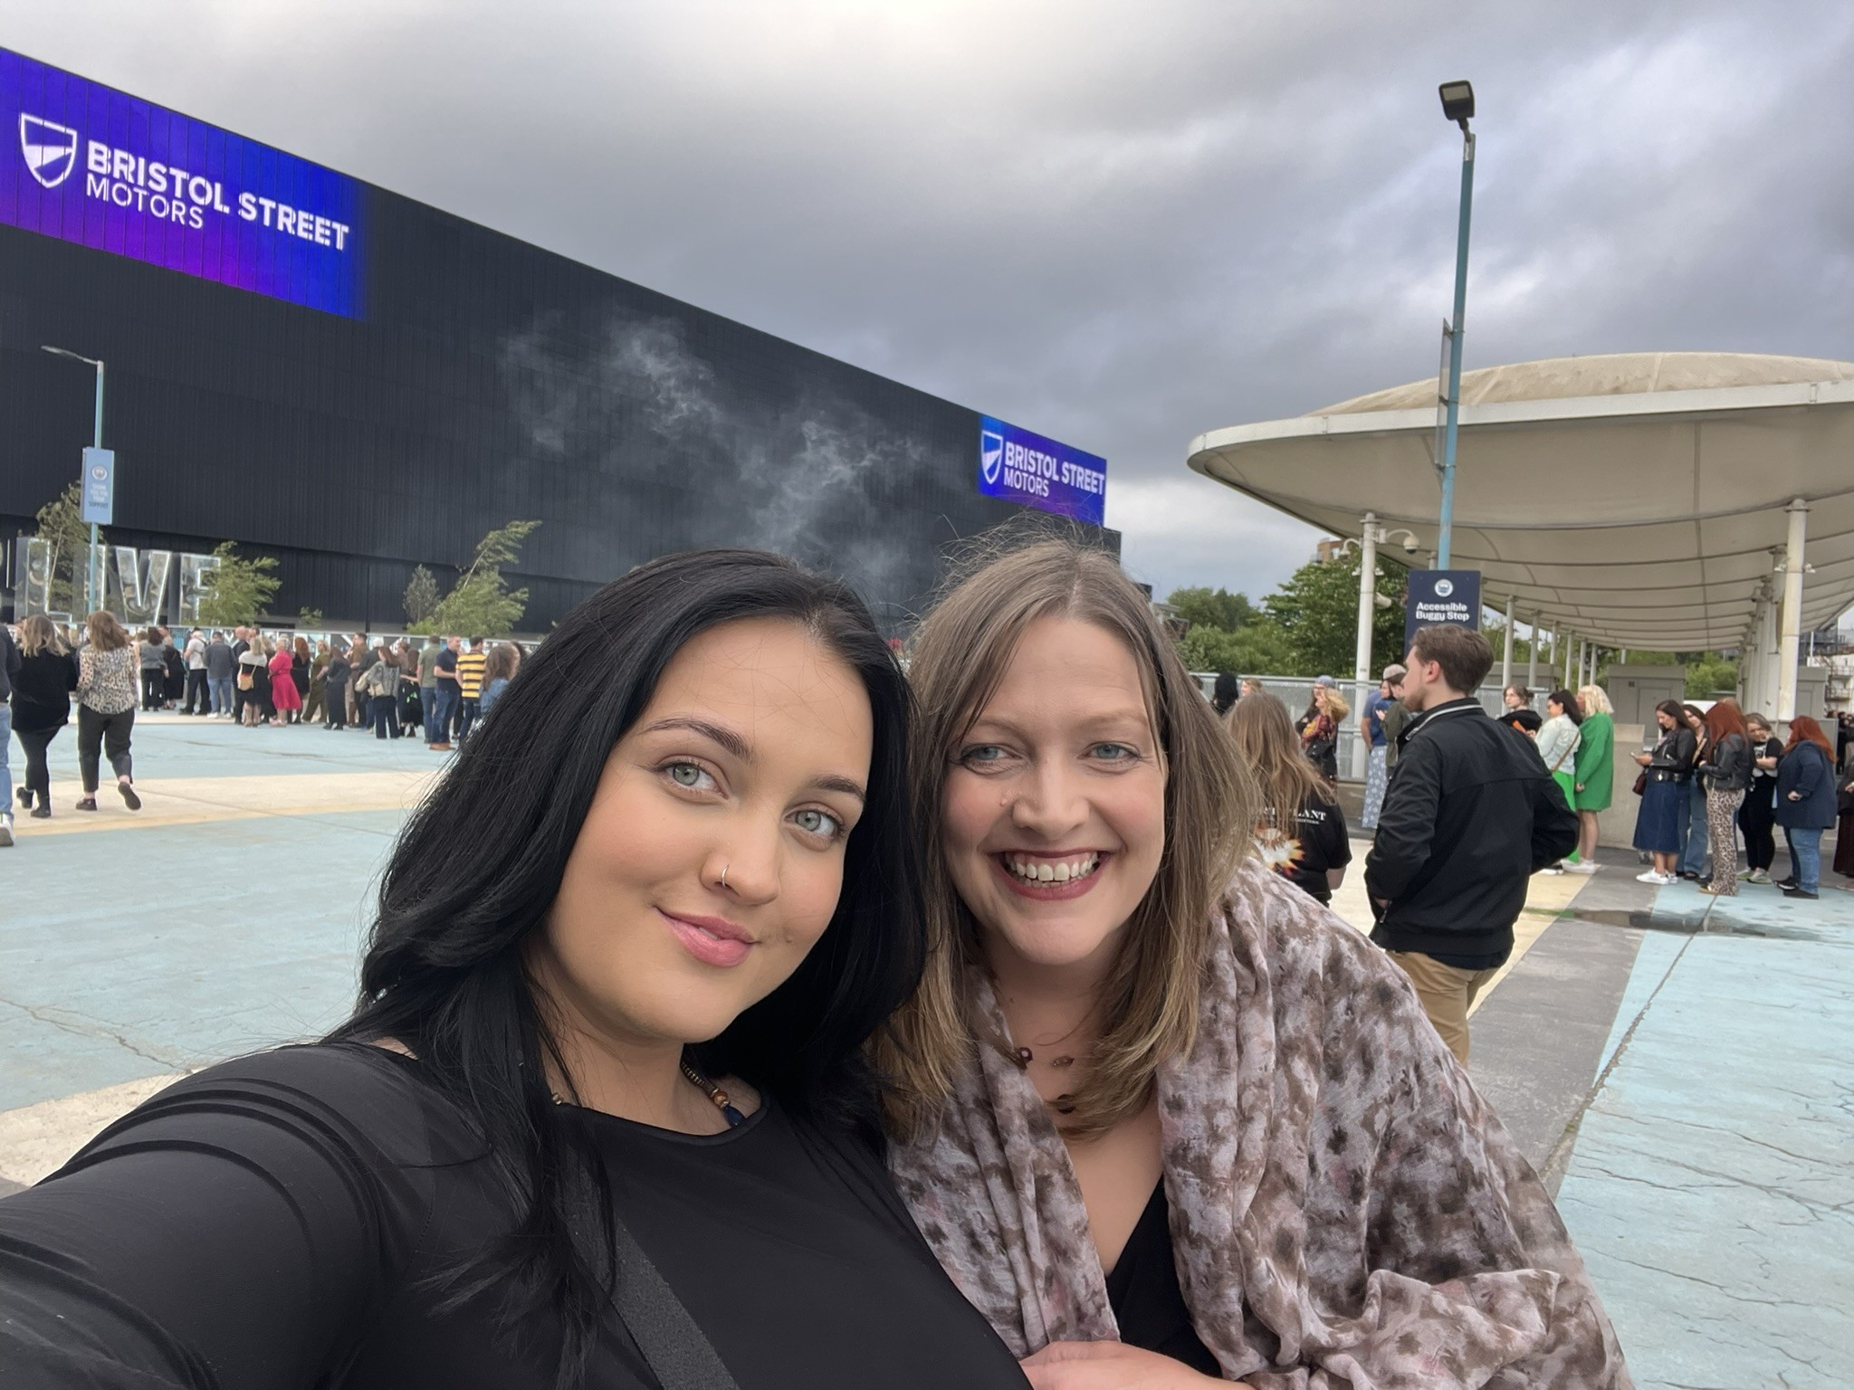
Rachel Heron
Information Officer at the University of Manchester
Expertise in research ethics and governance
Enjoy live music

Slide 27
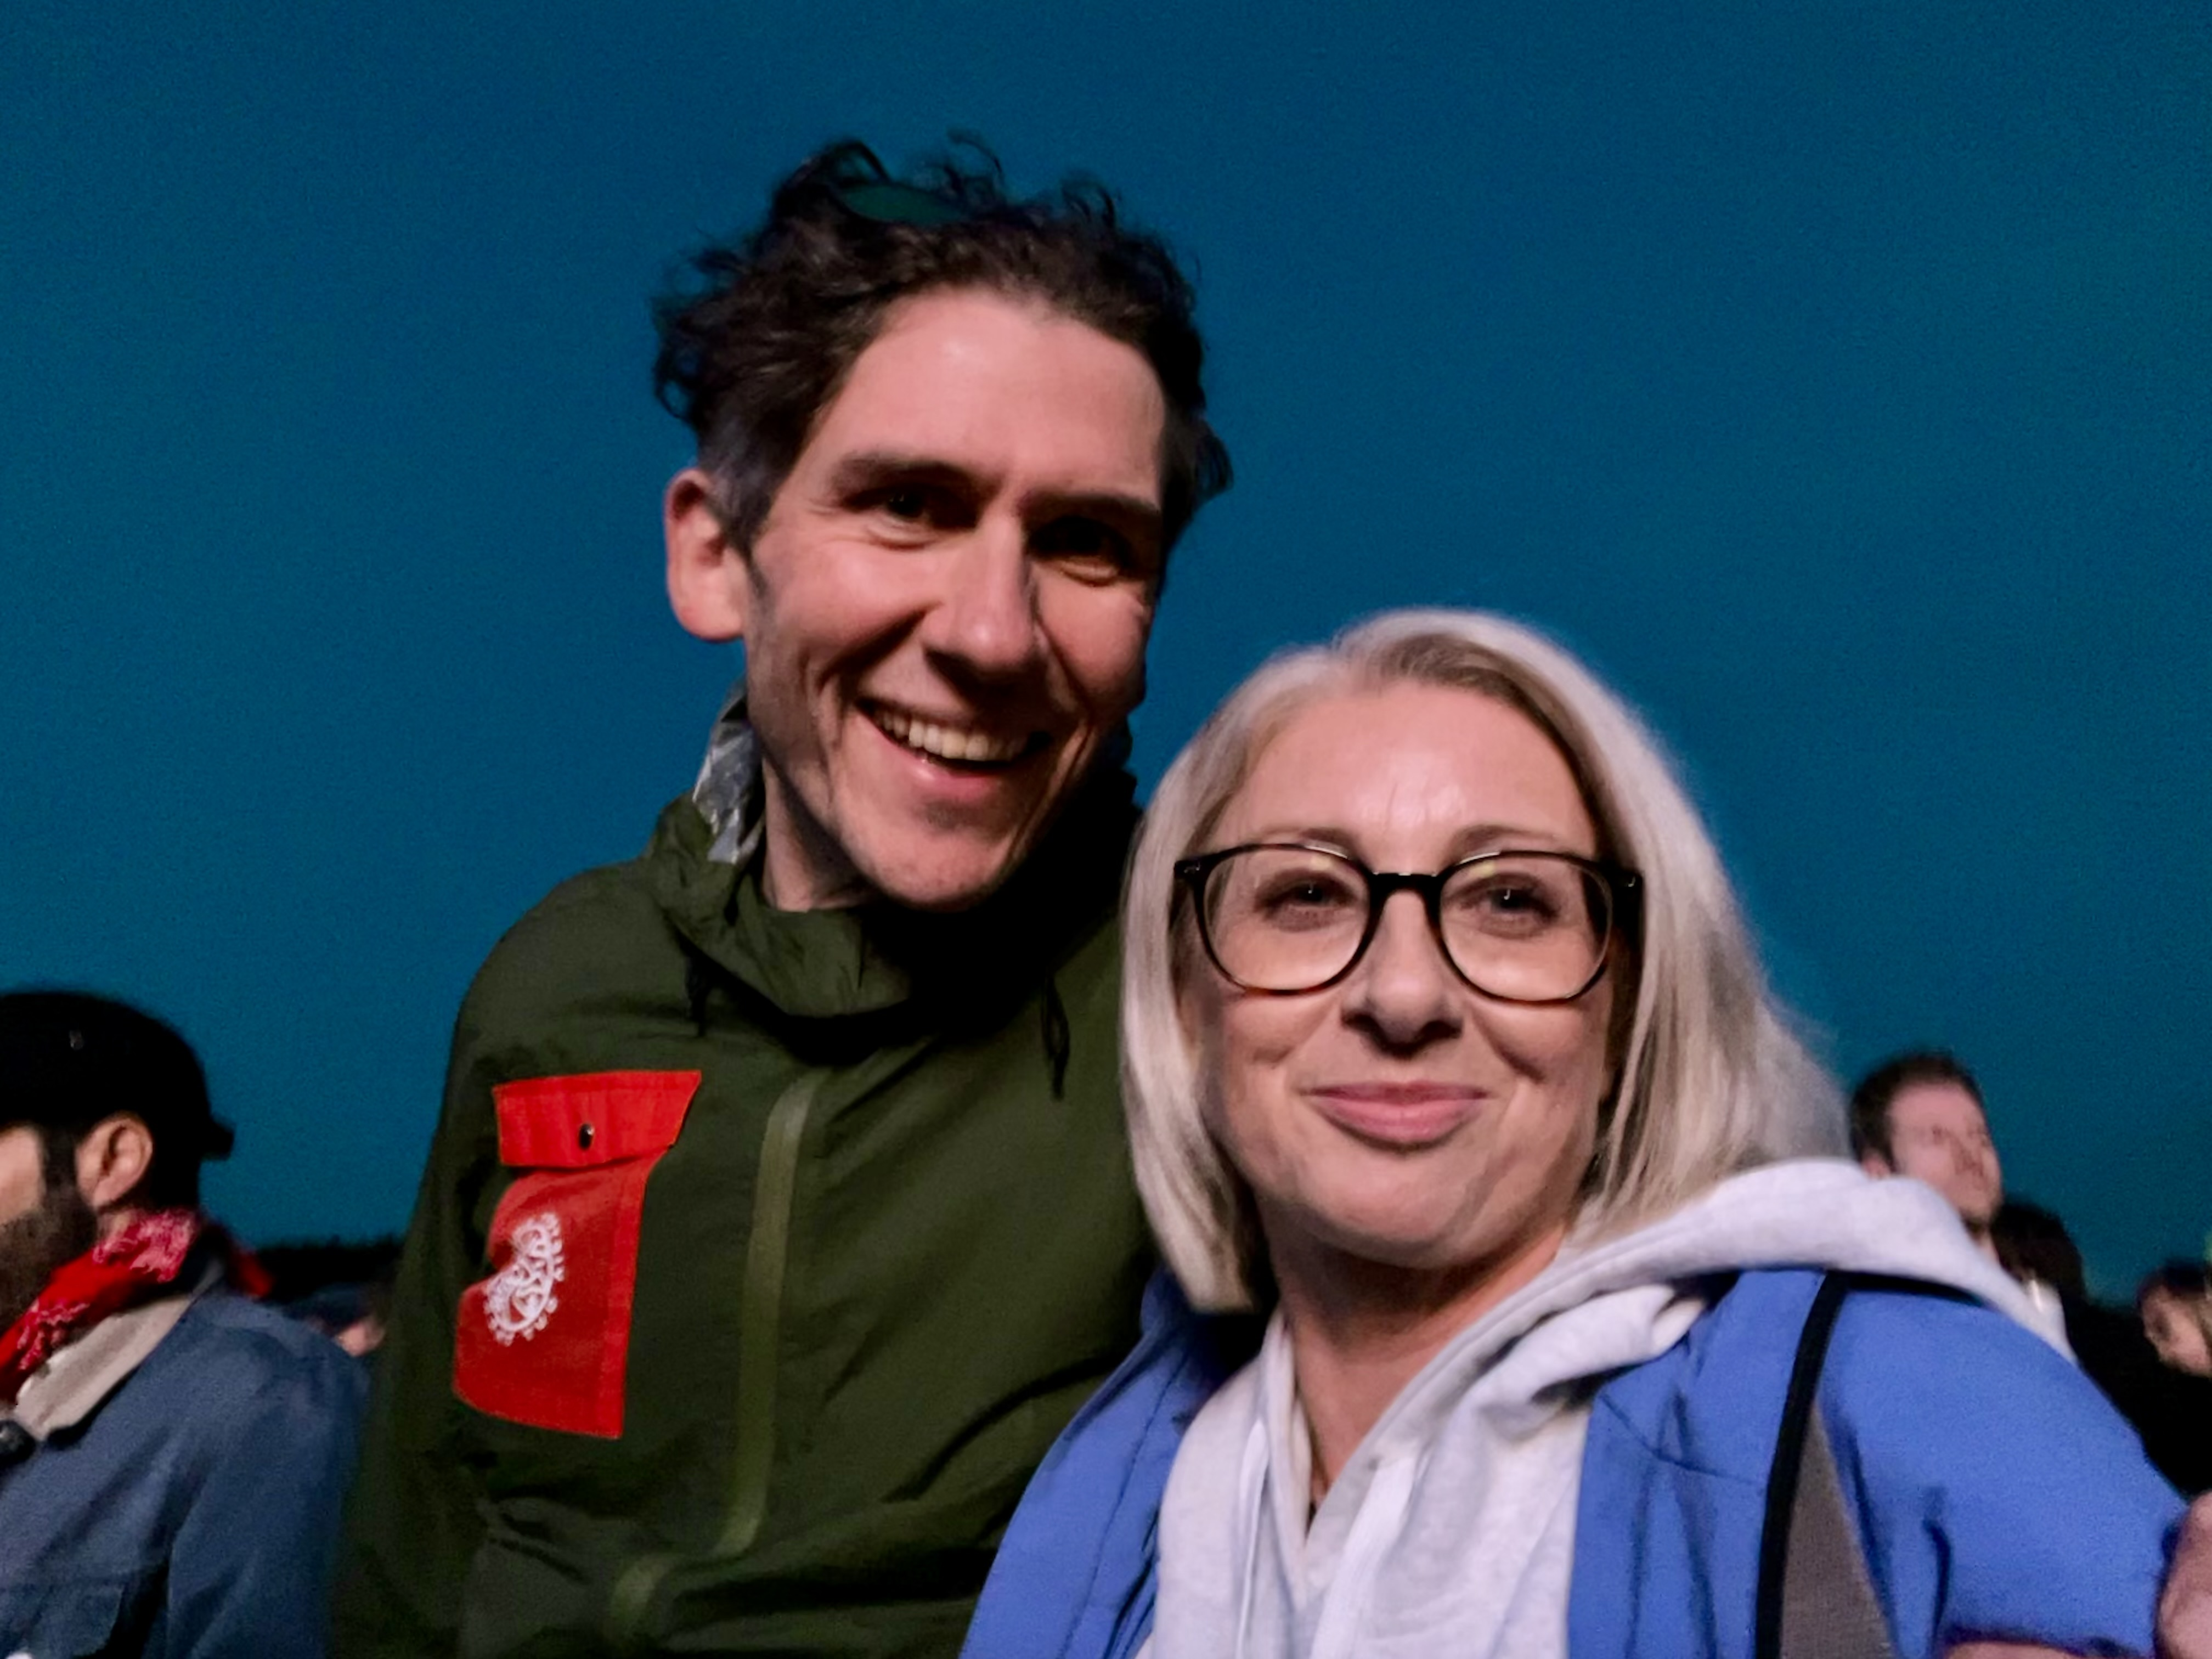
Louise Cook
Programme Manager for Health Research from Home
Loves live music (photo at New Order/ Johnny Marr/ Roisin Murphy last summer)
Also loves walking on the moors with my 2 dogs, and yoga (preferably without dogs)

Slide 28
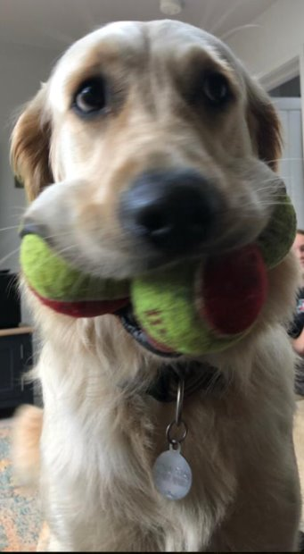
Richard Dobson
Professor of Medical Informatics
Deputy Director of the NIHR Maudsley BRC
Co-I for Health Research from Home, Technology Clinics Lead
Enjoy running and wing foiling. Often accompanied by my dog who insists on carrying 3 tennis balls at all times.

Slide 29
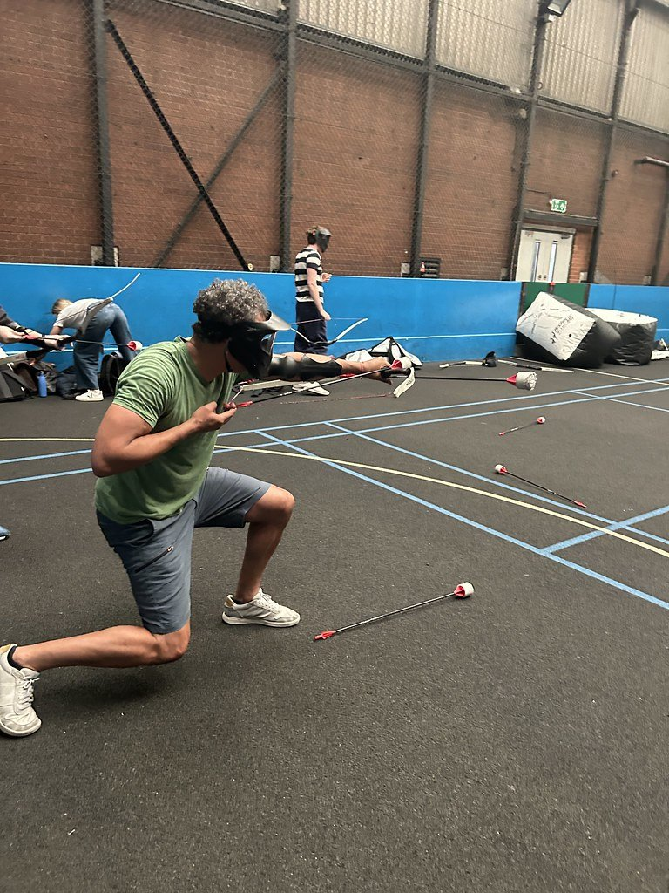
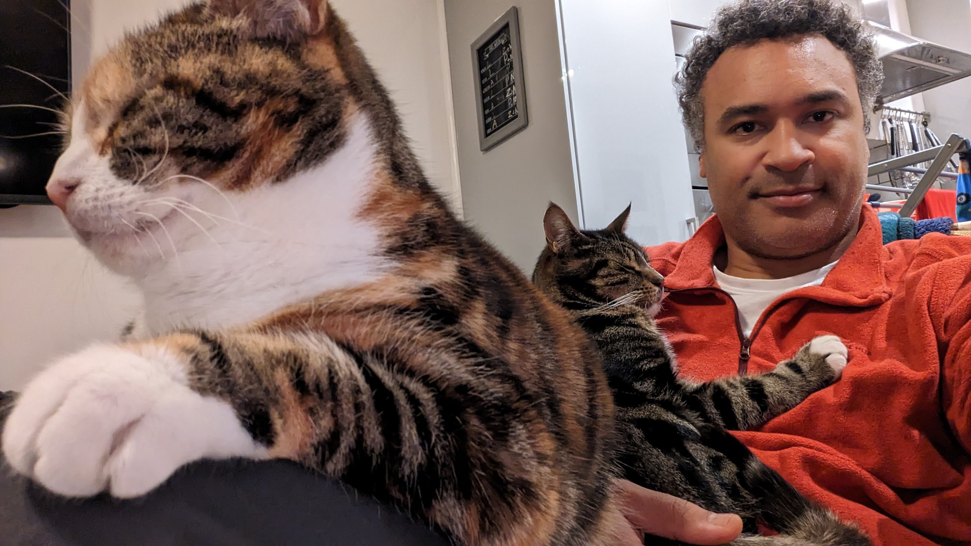
Amos Folarin
Dr of Bioinformatics
Founder of the RADAR-base platform
CEO of Onsentia
Improving archer, occasional cat bed

Slide 30
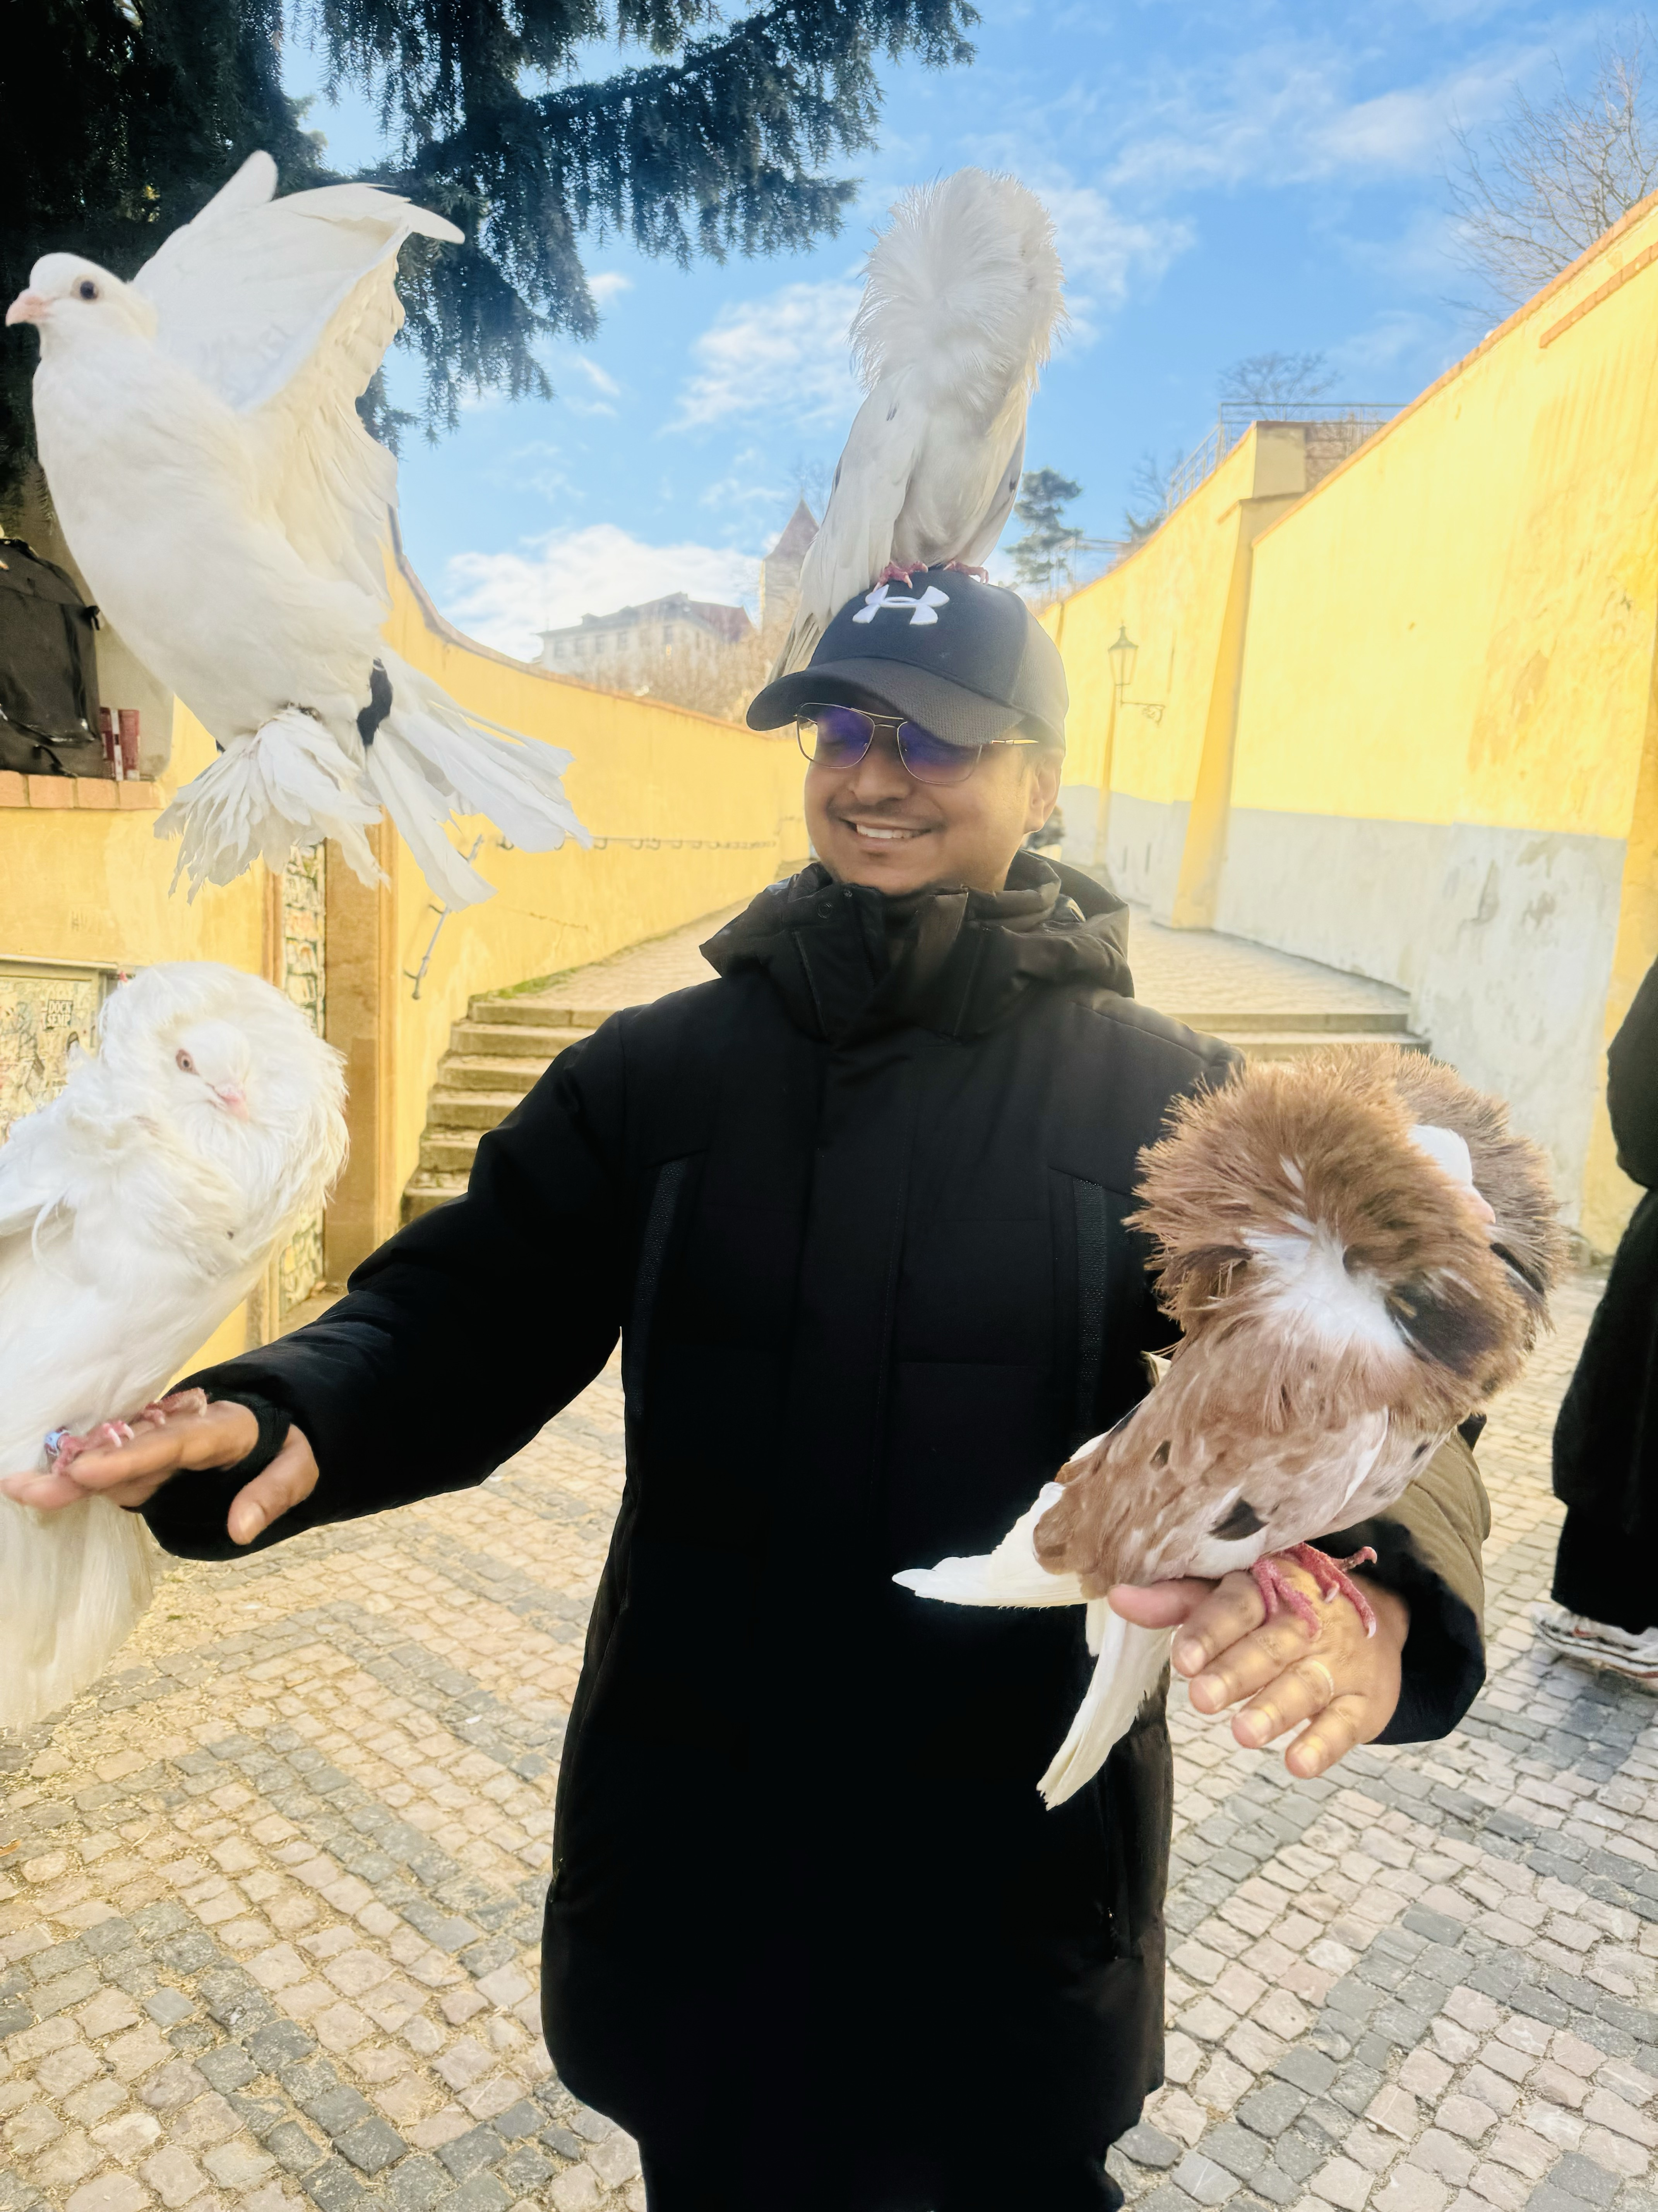
Yatharth Ranjan
Senior Software Engineer, mHealth, BRC, IoPPN, King’s College London - RADAR-base platform
CTO, Onsentia
Beyond my work, I like to travel and connect with nature in unexpected ways.
Prone to spontaneous avian encounters.

Slide 32
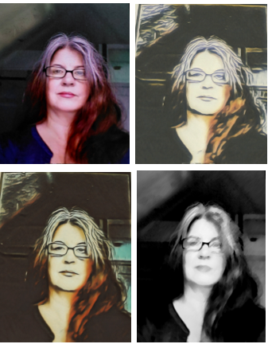
Karen Finney
Add picture outside of work
MRC Programme Manager
Population and Systems Medicine Board
Art; photography; film noir
Japanese koi watcher

Slide 33
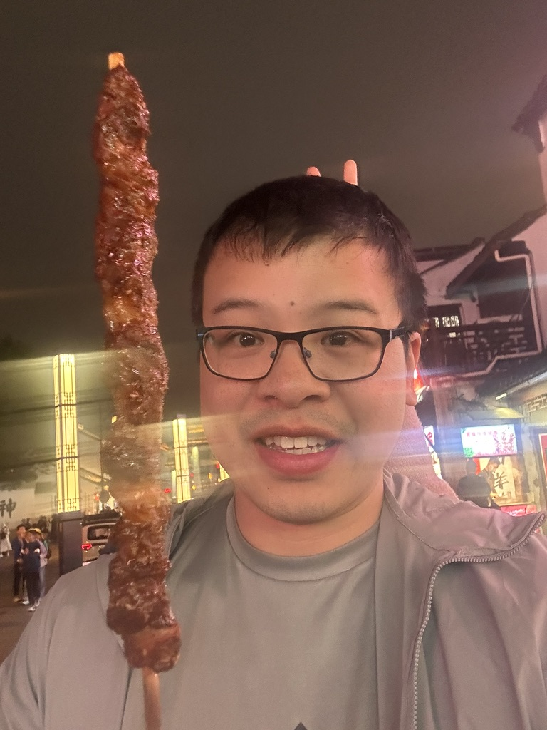
Chris Yau
Add picture outside of work
Professor of Artificial Intelligence (Oxford) and
Programme Director for Capacity Building (Health Data Research UK)
I like food (lamb kebab stick in China)

Slide 34


Slide 35
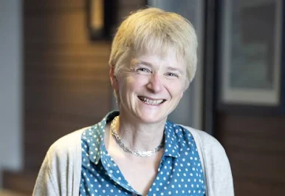
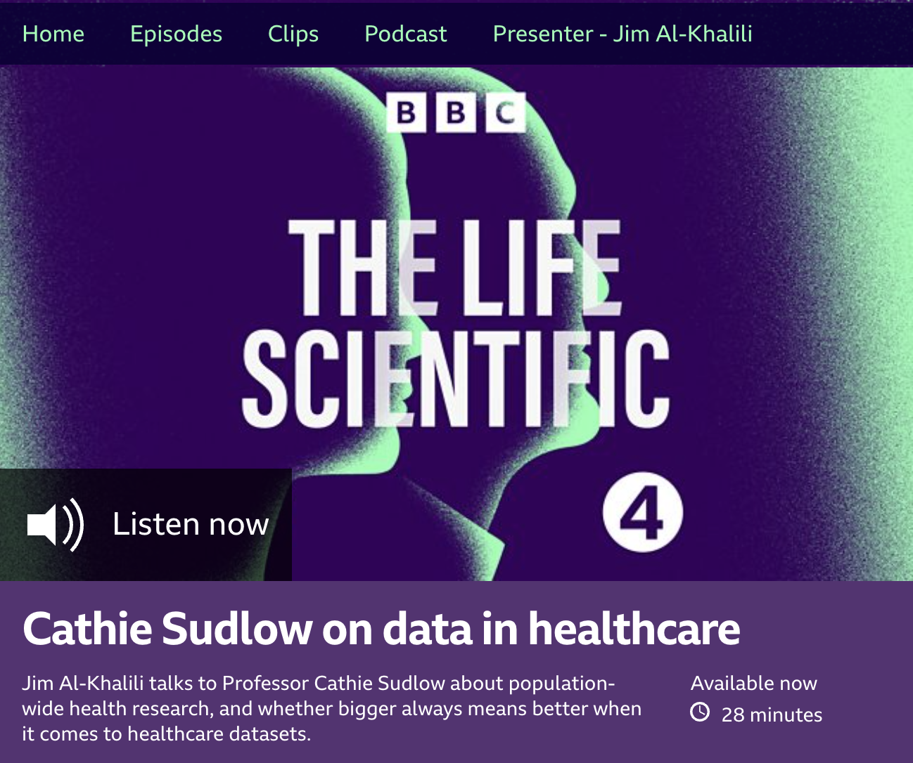
Cathie Sudlow
Director, Usher Institute
Director, Adolescent Health Study
Strategic Advisor, HDR UK

Slide 36
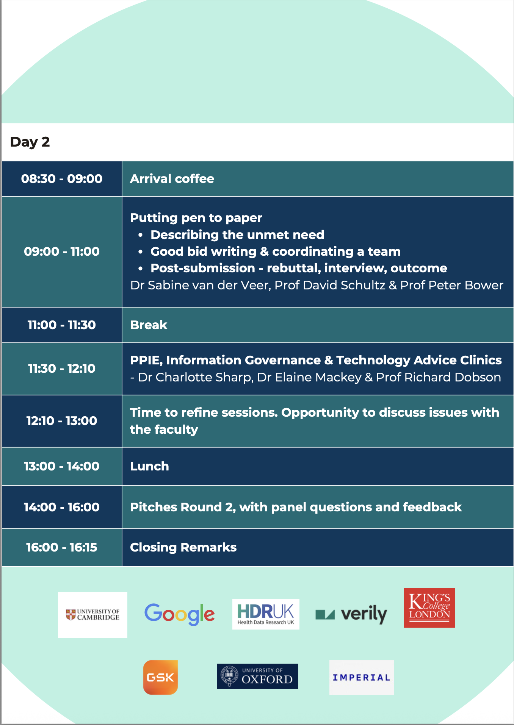

Slide 37
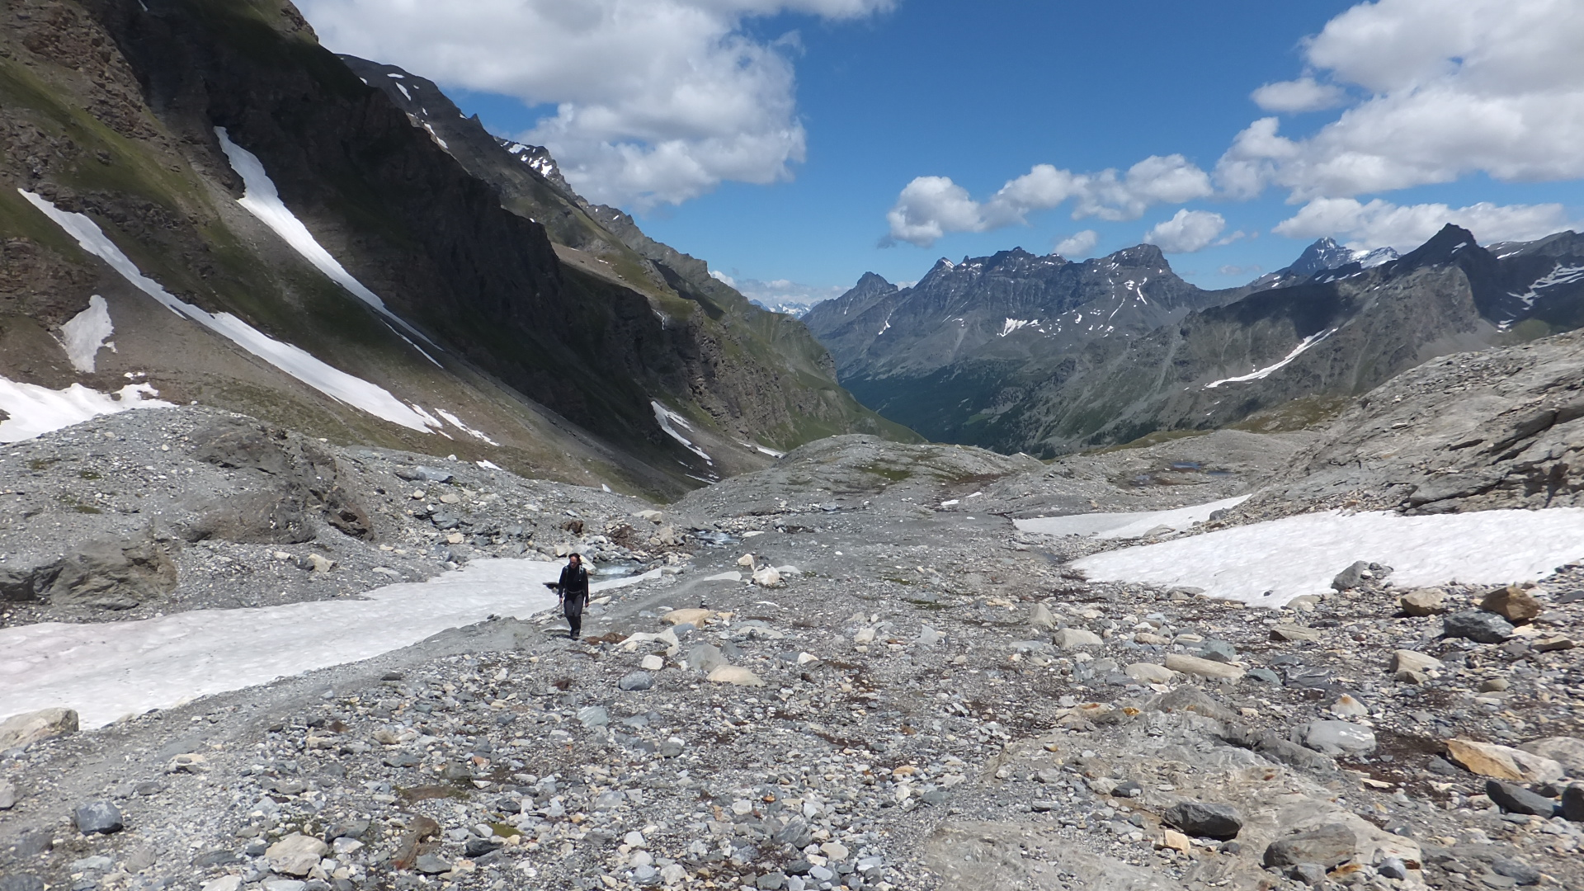
Sabine van der Veer
Senior Lecturer in Health Informatics
Co-investigator Health Research from Home
Loves a mountainous hike
Enjoys bird watching and brutalist architecture

Slide 38
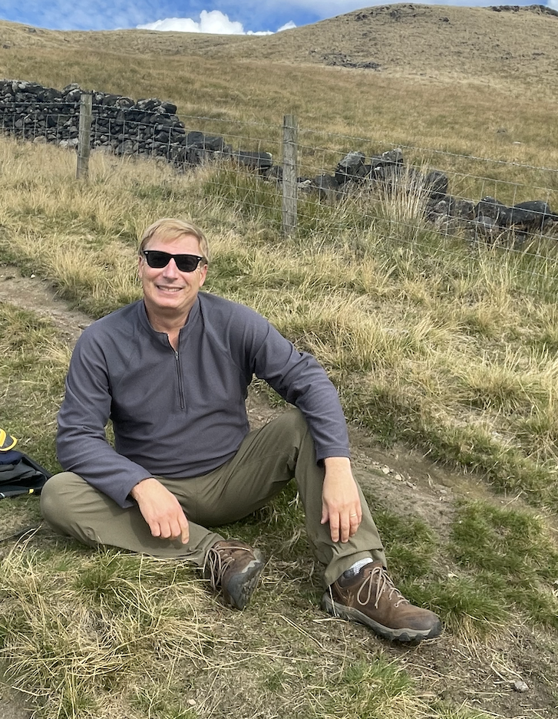
David Schultz
Add picture outside of work
Prof of Synoptic Meteorology
Author of Eloquent Science: A Practical Guide to Becoming a Better Writer, Speaker, and (Atmospheric) Scientist
Will’s hired help
Looking cool while hiking
Finding the best Effin’ Birds cartoon for any given situation

Slide 39
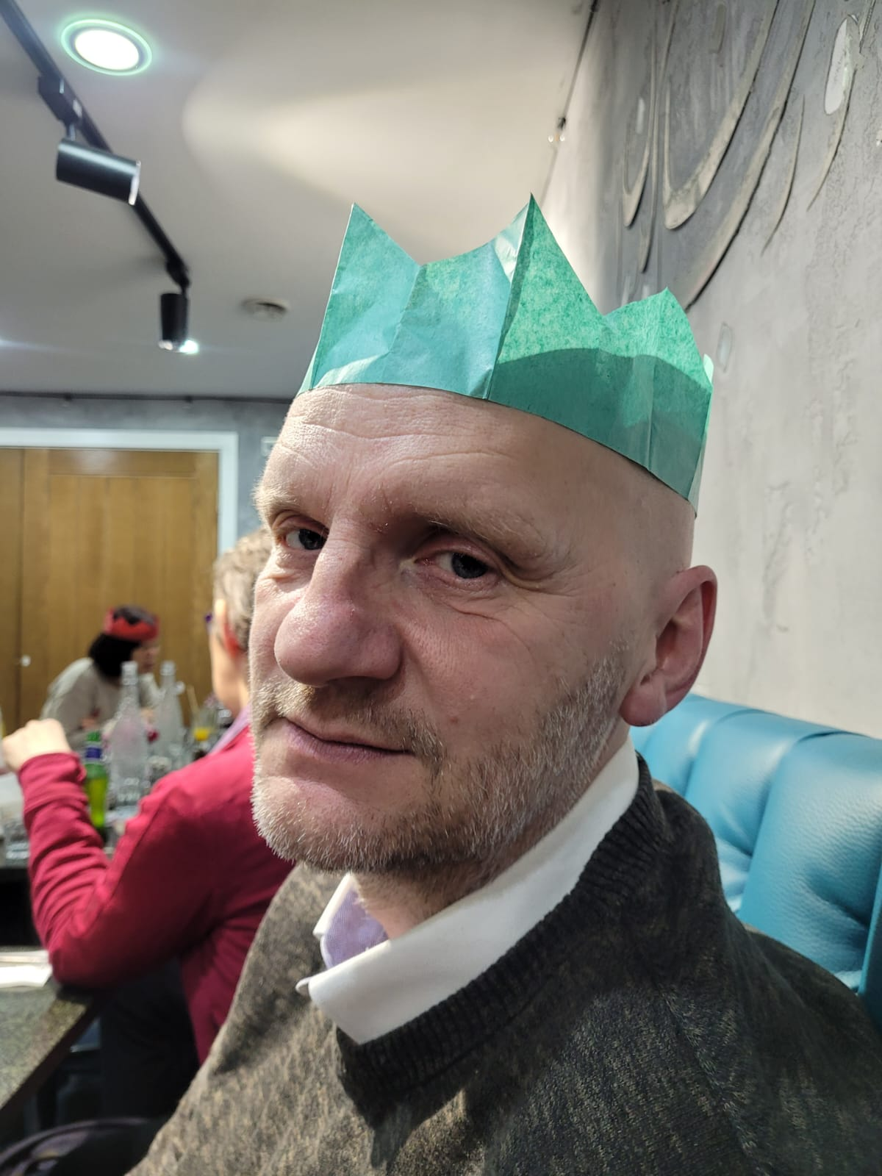
Peter Bower
Ad picture outside of work
Health services researcher
Occasional ‘reviewer 2’
Party lover

Slide 41
Pitches v2
Judging criteria
• Background and clarity of unmet need
• Clear research Q, with appropriately matched methods
• Well designed PPI plans
• Well articulated need for smartphones & wearables, with feasible plans for technology delivery
• Response to panel’s questions
Prepare an oral presentation of no more than eight minutes
Present as an individual or team
Must include
Background
Aims and objectives
Methods
PPIE/ technology/ IG (the advice clinics)
Anything else you think important
Two minutes Q&A
Prizes

Slide 43
Faculty hosting the pitches v1 Two academics, one public contributor/ PPIE
Breakout group 1:
Will, Richard & Leila
Breakout Group 2:
Sabine, Soren & Jane
Breakout Group 3:
Charlotte, Chris & Hannah

Slide 44
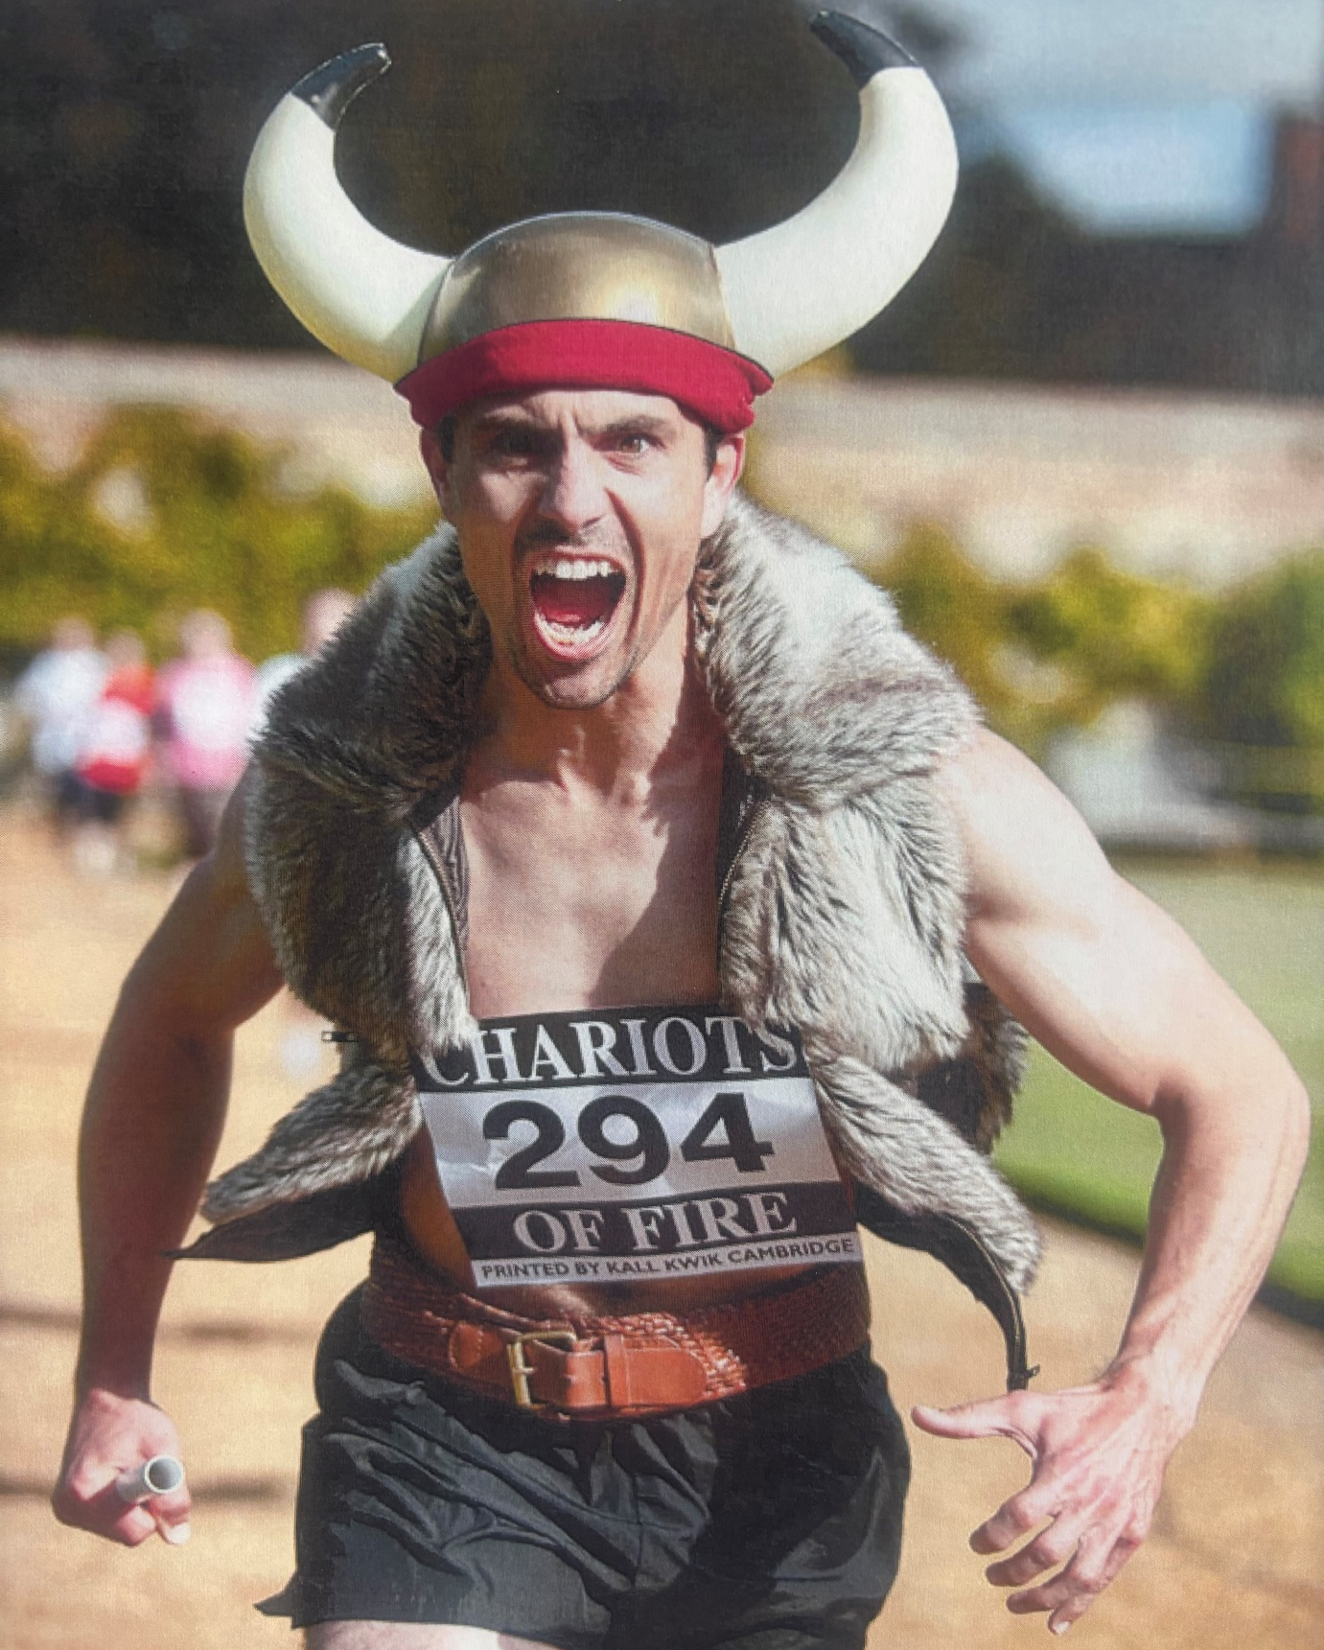
Søren Brage
Add picture outside of work
Physical epidemiologist
MRC Program Leader
Darwinian grant writer
Enjoys intense and crazy (science, history, running, family time, DIY)

Slide 45
Opening session
Introduction to Health Research from Home
Purpose of the grant writing retreat
Agenda for the event
And introduction to the faculty
Getting to know you

Slide 46
Group 1: Will, Richard & Leila (Innovation)
- Shaoxiong Sun - Chelsea Sawyer
- Matthew Taylor - Ellie Asgari
- Sampurna Kundu - Samarul Islam
- Aminu Umar
Group 2: Sabine, Soren & Jane (Boardroom)
- Oli Fiassam - Milly Lo
- Chris Knowles - Devon Ramey
Thomas Paterson - Larisa-Maria Dinu
- Steve Lukito
Group 3: Charlotte, Chris & Hannah (Rutherford)
- Samuel Warne - Ning Wang
- Pamela Almeida - Julia Zollner
- Mattia Coriano' - Muhammad Fahim
- Aron Syversen

Slide 47
Group 1: Will, Richard & Leila
1400-1440 PPIE (Rutherford)
1440-1520 Information Governance
Day 2 Technology
Group 2: Sabine, Soren & Jane
1400-1440 Technology (Innovation)
1440-1520 PPIE
Day 2 Information Governance
Group 3: Charlotte, Chris & Hannah
- 1400-1440 Information Governance (Boardroom)
1440-1520 Technology
Day 2 PPIE

